Slide 1
Watershed-wide efforts
USFS West Carson Project
U.S. EPA and Lahontan Water Board “Program Vision” prioritizing West Carson
CWSD Adaptive Stewardship Plan

Slide 2
USFS West Carson Project
Headwaters to ~Sorenson’s
Landscape view for restoration planning
Includes:
Aspen stand restoration
Vegetation management – including fuels management, restoration, and forest health treatments
Improve habitat for the endangered Sierra Nevada yellow-legged frog near Tamarack and Sunset Lakes
Restoration of stream and meadow
Questions?
Carson Ranger District
775-882-2766

Slide 3
U.S. EPA “Program Vision” framework
Implemented with Lahontan Regional Water Quality Control Board
West Fork Carson chosen as a Priority Watershed
The New Program Vision incorporates experience gained over the last two decades from developing nearly 65,000 TMDLs.
A TMDL establishes the maximum amount of a pollutant allowed in a waterbody and serves as the starting point or planning tool for restoring water quality.
The vision seeks to provide states with more flexibility by offering tools beyond TMDLs for achieving water quality restoration and by allowing states to tailor their program to meet specific needs and goals.
by 2014, states and EPA will actively engage the public and stakeholders in protecting water quality;
by 2016, states will report on priority waters or watersheds for inclusion in state strategic planning. States also will identify protection planning priorities for healthy waters. Further, states will coordinate implementation and foster integration of point and nonpoint source control actions;
by 2018, states can use alternative approaches, such as adaptive management; and
by 2020, states will report on the extent of both impaired and healthy waters in priority waters or watersheds.

Slide 4
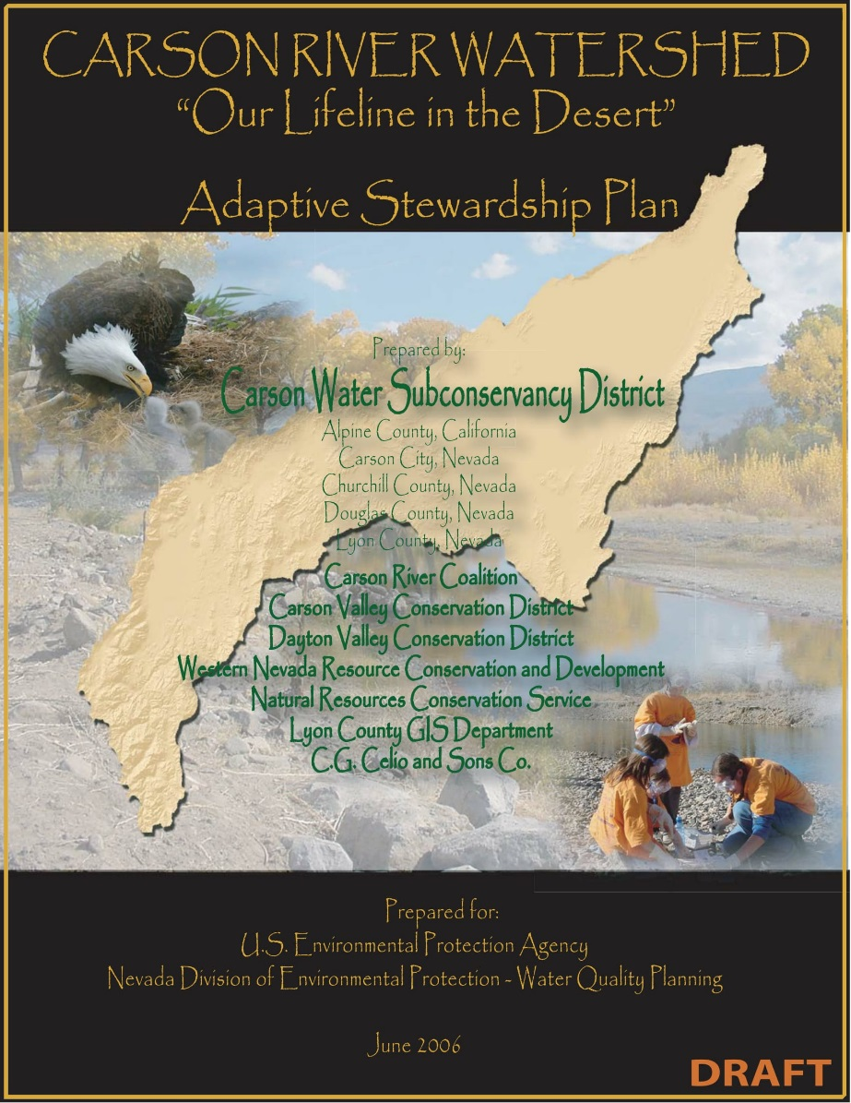
CWSD Carson River Adaptive Stewardship Plan Update
Update to the May 2007 document
Basically a watershed plan, should have 9 elements required by EPA to make 319(h) federal funds available.
Includes:
Past, present, and future projects
Existing conditions
Management measures and implementation
and funding needs
Questions?
Contact Brenda Hunt, Carson Water Subconservancy District (CWSD)
brenda@cwsd.org

Slide 5
Some specific projects
USFS West Carson Project
U.S. EPA and Lahontan Water Board “Program Vision” prioritizing West Carson
CWSD Adaptive Stewardship Plan

Slide 6
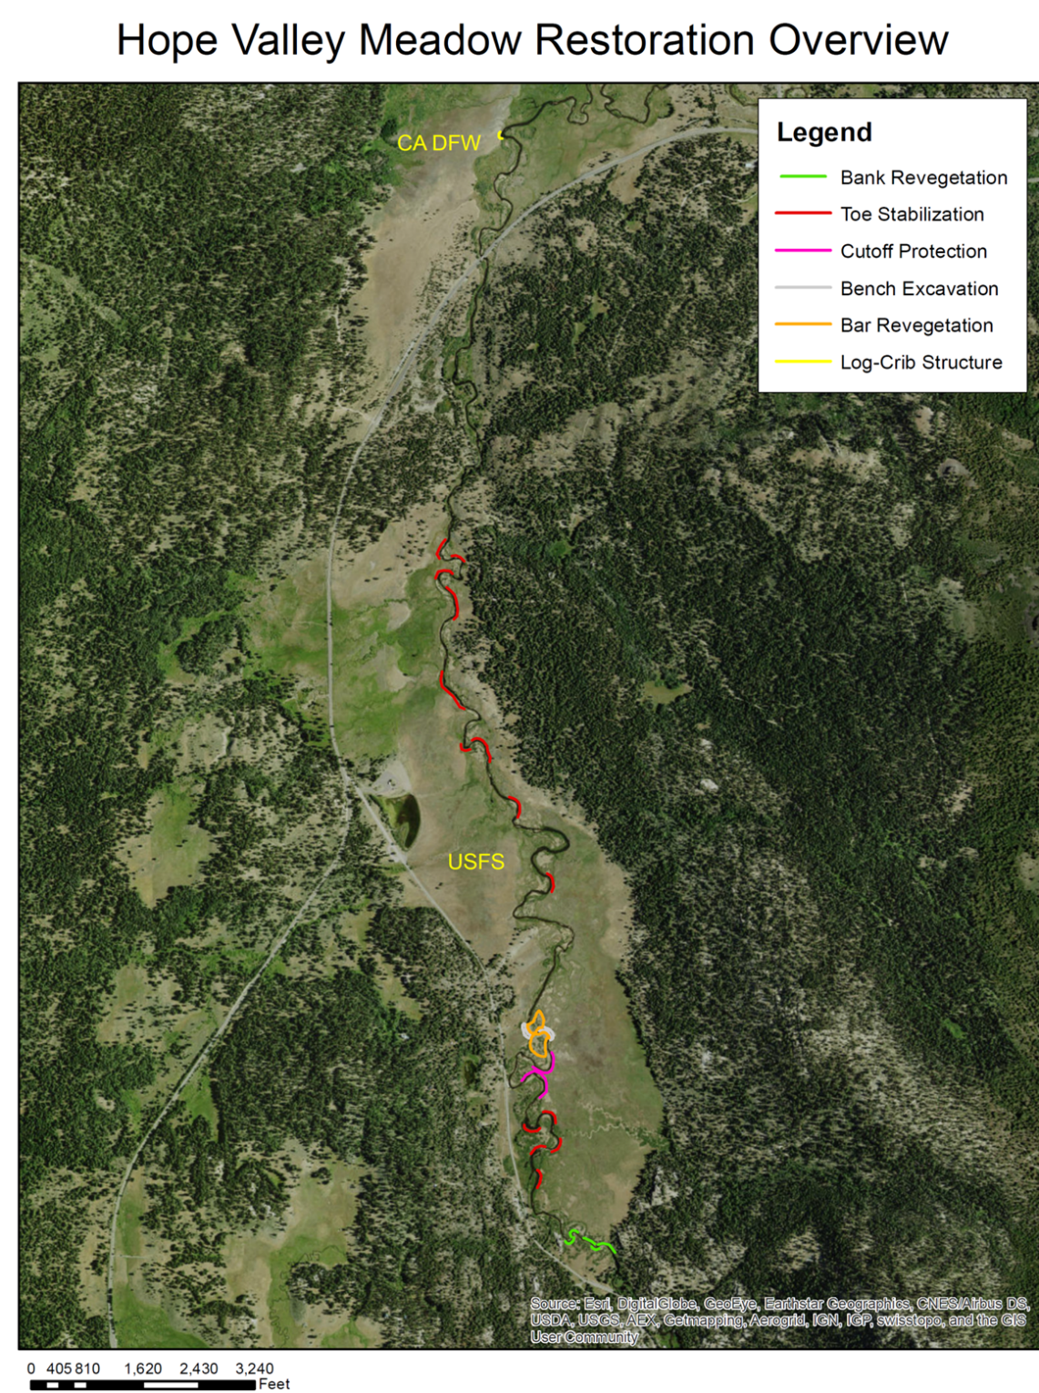
Completed October 2016
5 Primary Restoration Activities
Vegetative Stabilization
Stabilization of Streambank Toes
Meander Cutoff Protection
3. Floodplain Benches
5. Log crib bank stabilization
(CA DFW)
Hand Labor – headcut repair
Repaired a total of 6045 feet (1.1 miles) of streambank
130 feet on CDFW implemented in Fall 2015

Slide 7
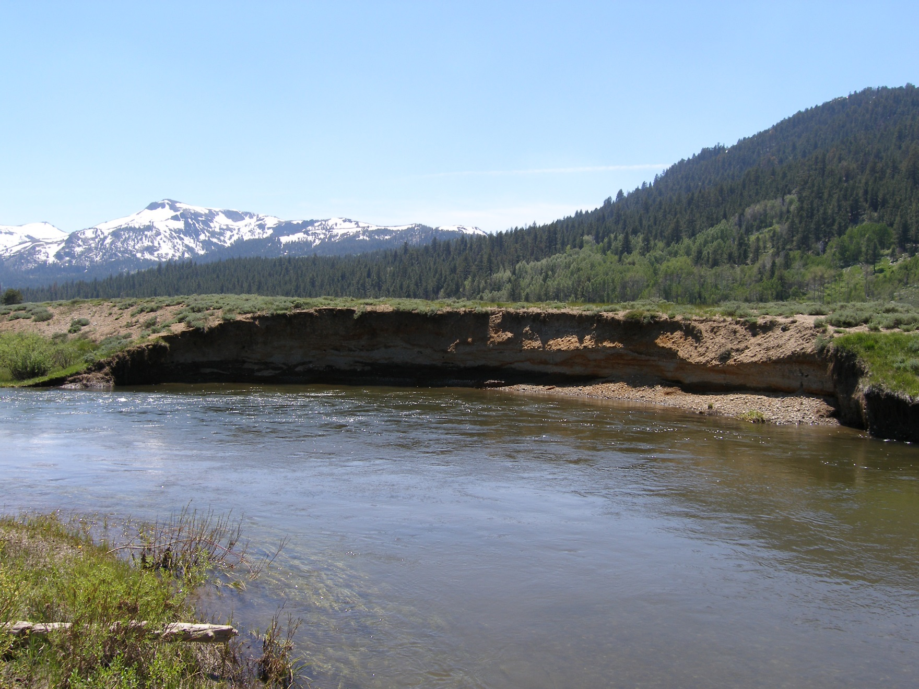
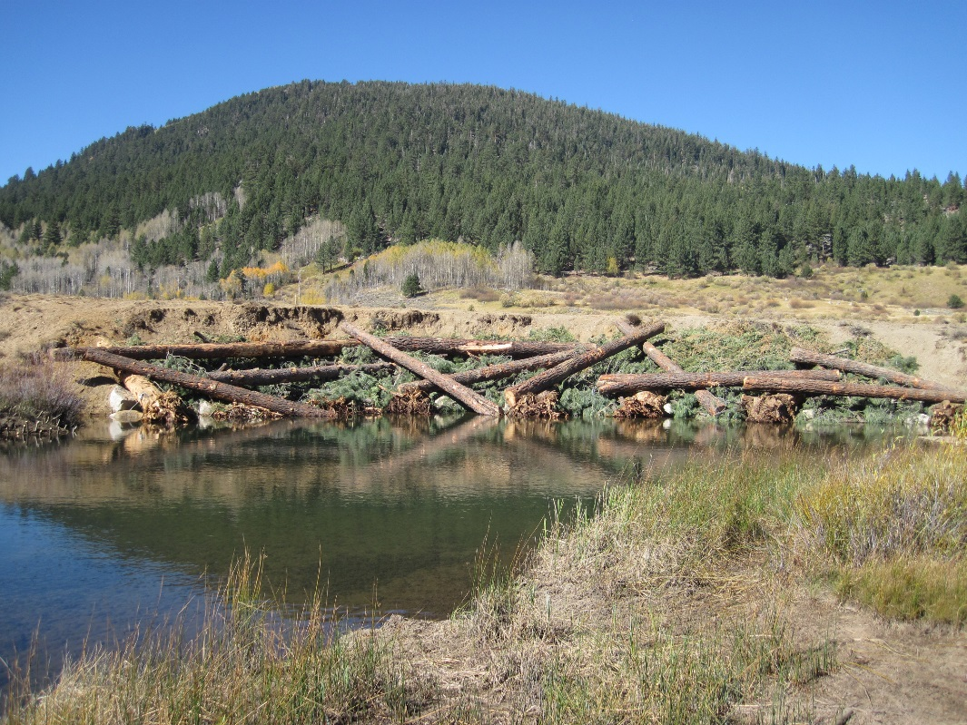
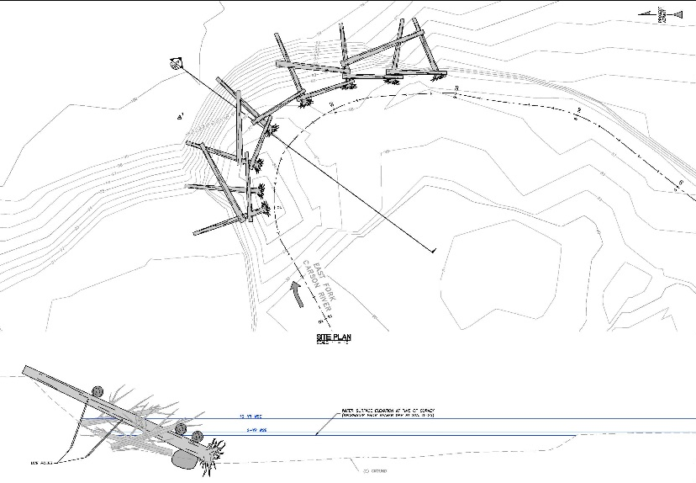
Log Crib Bank Stabilization
Implemented 2015 on CDFW land
Stabilize high, eroding bank using log-crib structure & willow plantings

Slide 8
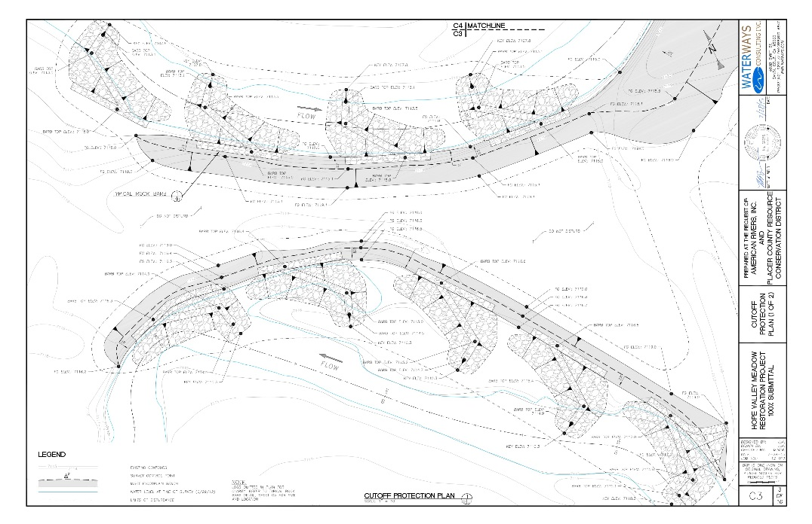
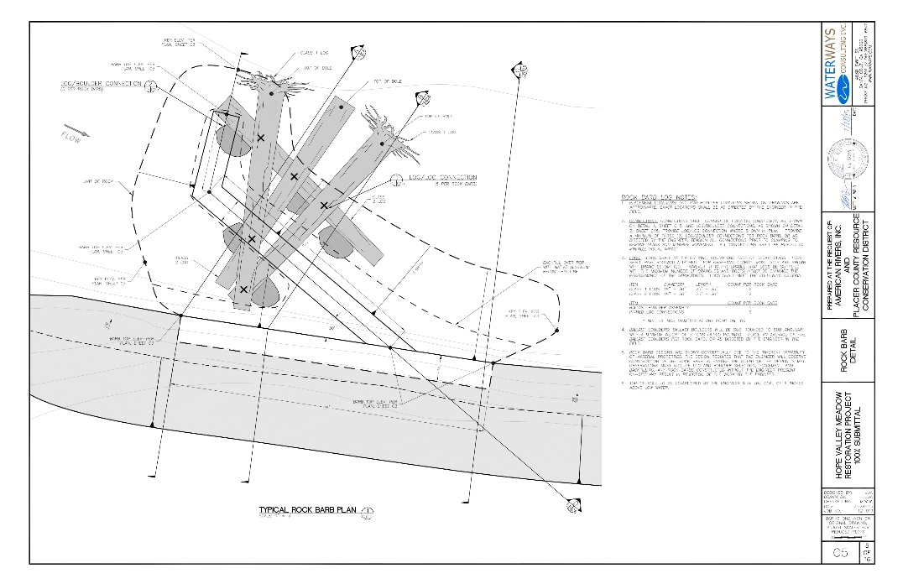
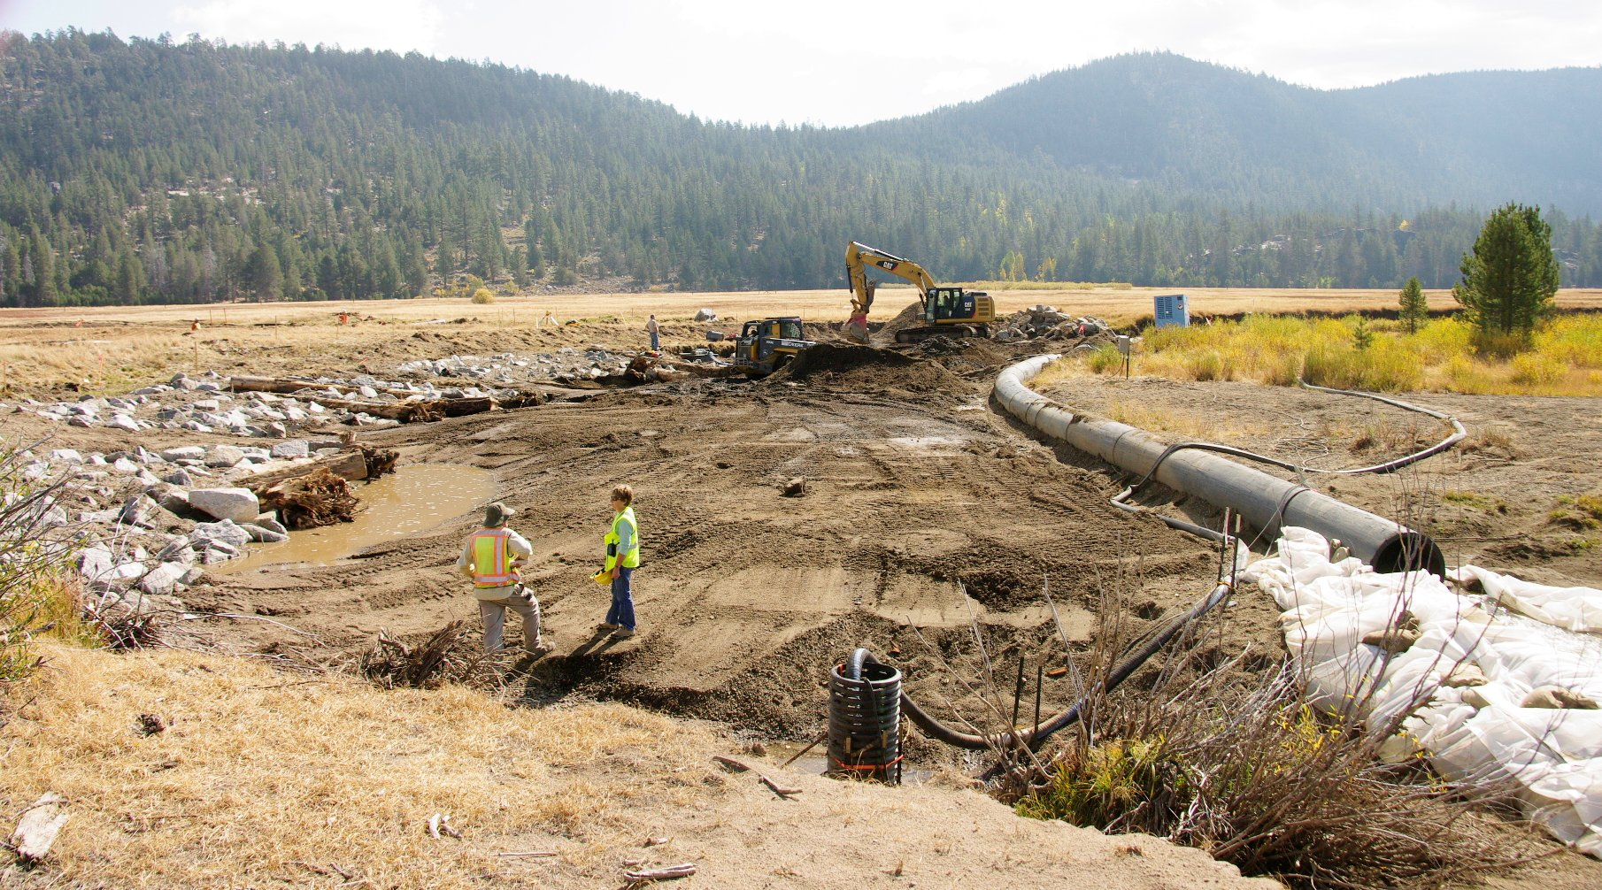
Cutoff Protection 9-29-16

Slide 9
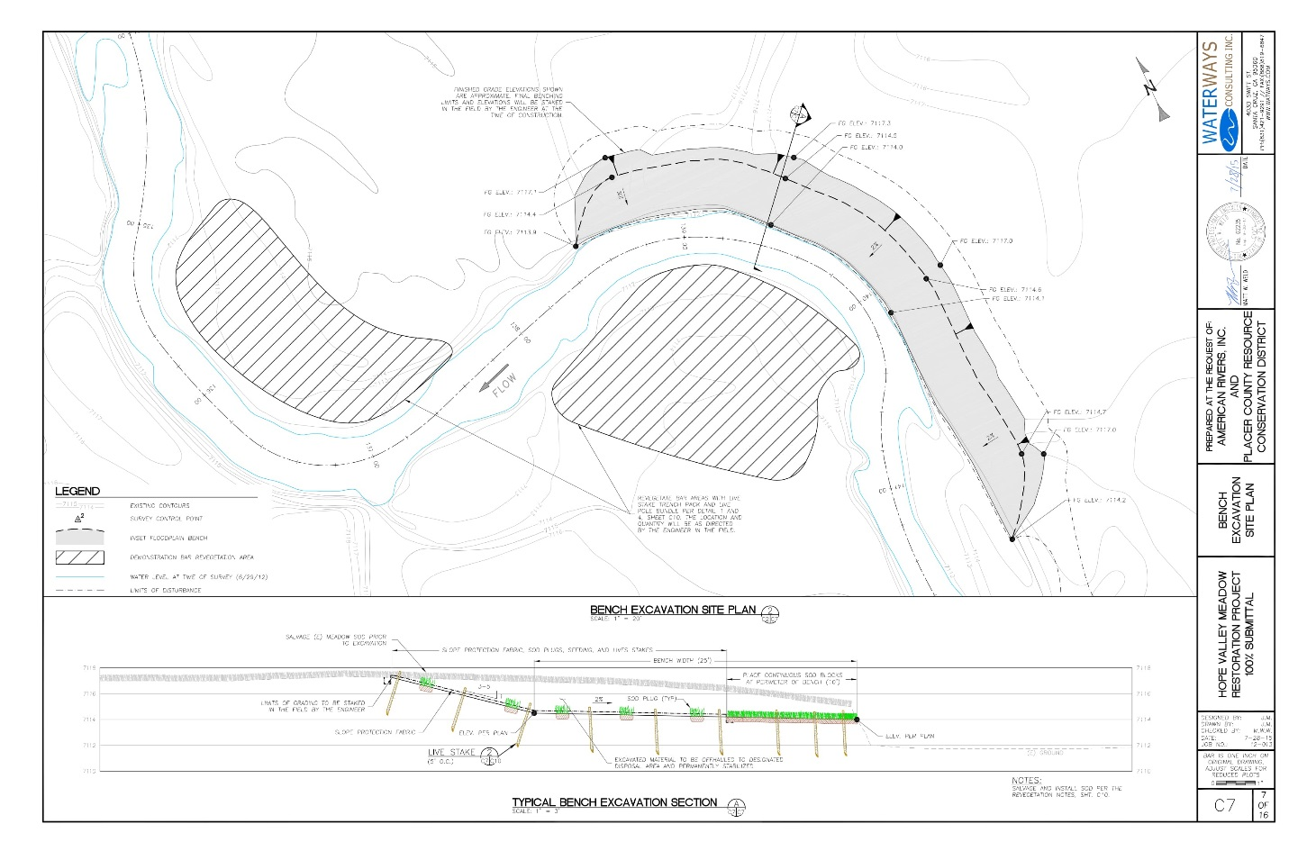
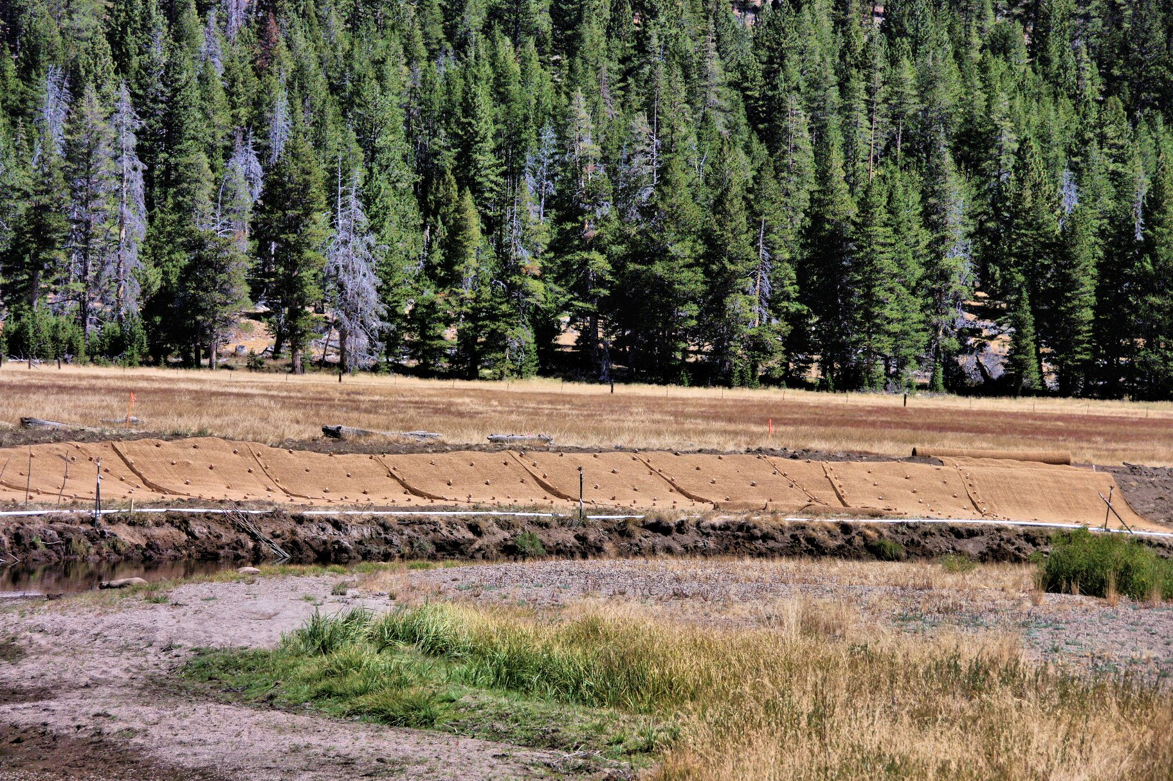
Toe stabilization 9-17-16

Slide 10
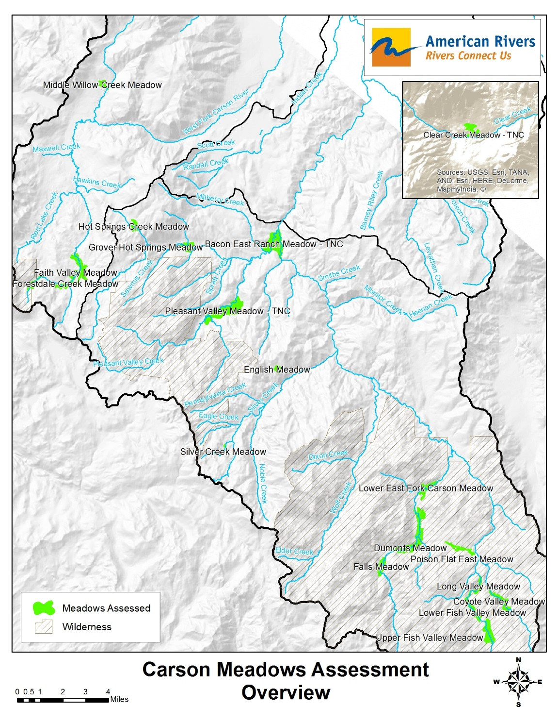
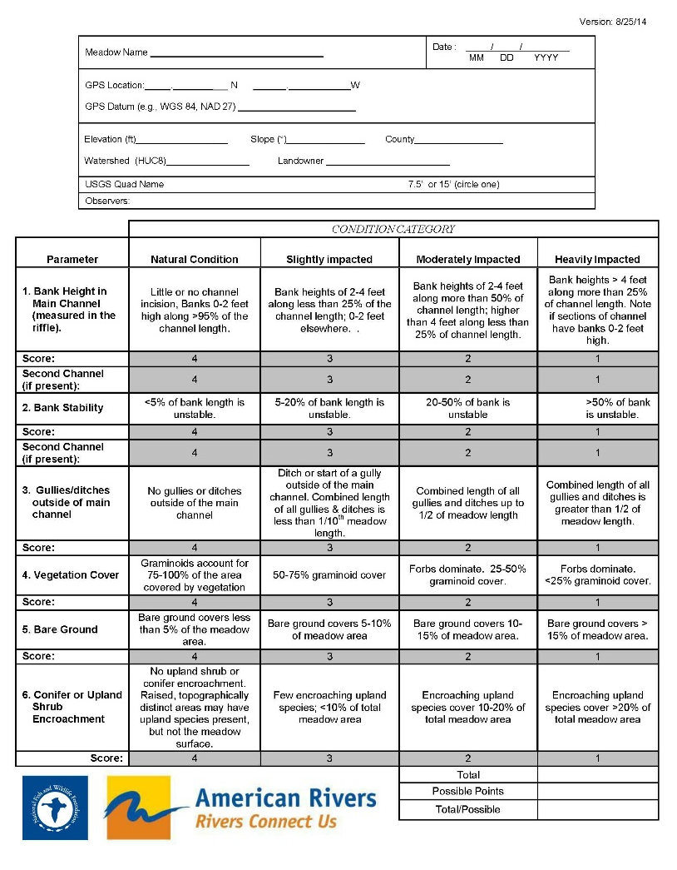
Carson Watershed Meadow Assessment
All publically accessible meadows in the Carson Watershed

Slide 11
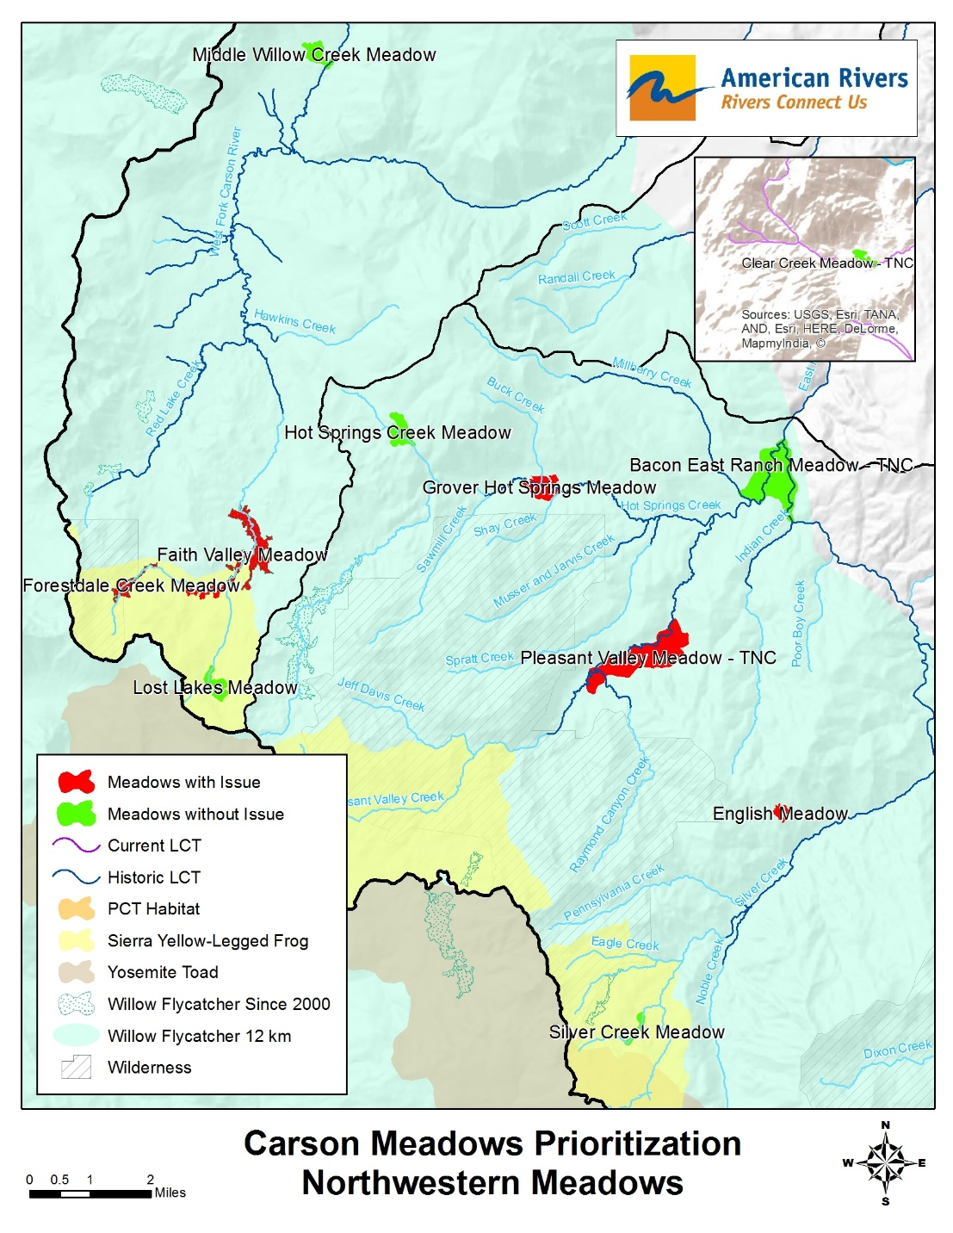
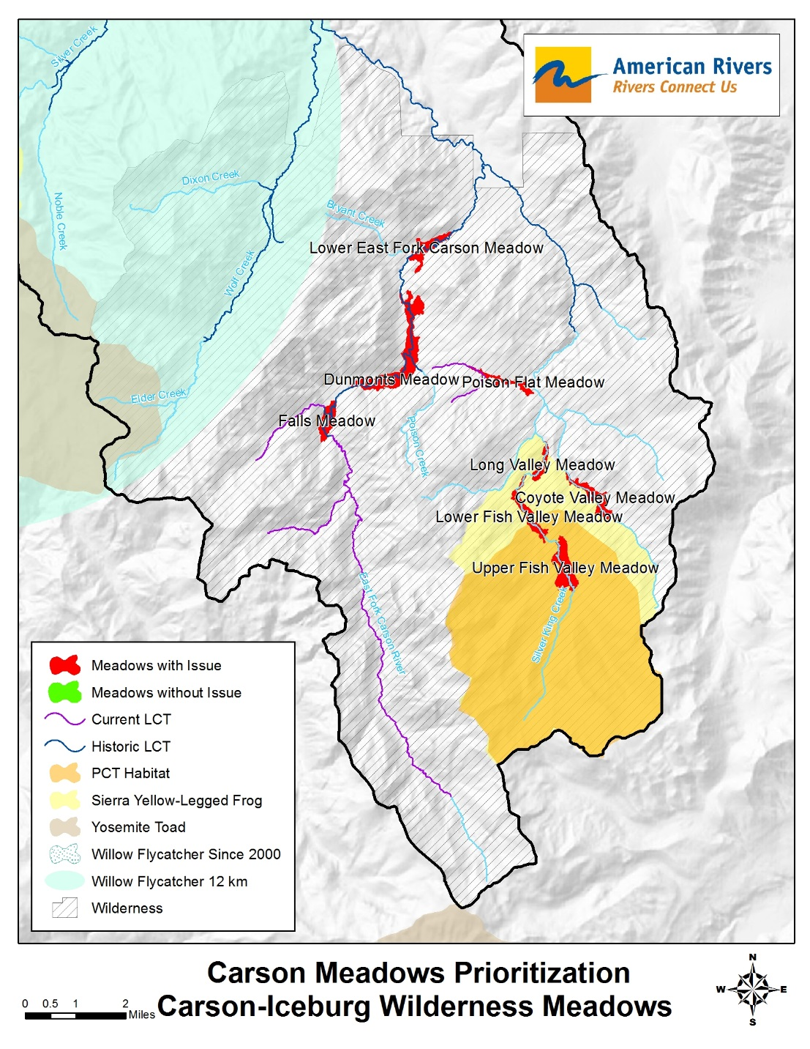
Working Toward Prioritization

Slide 12
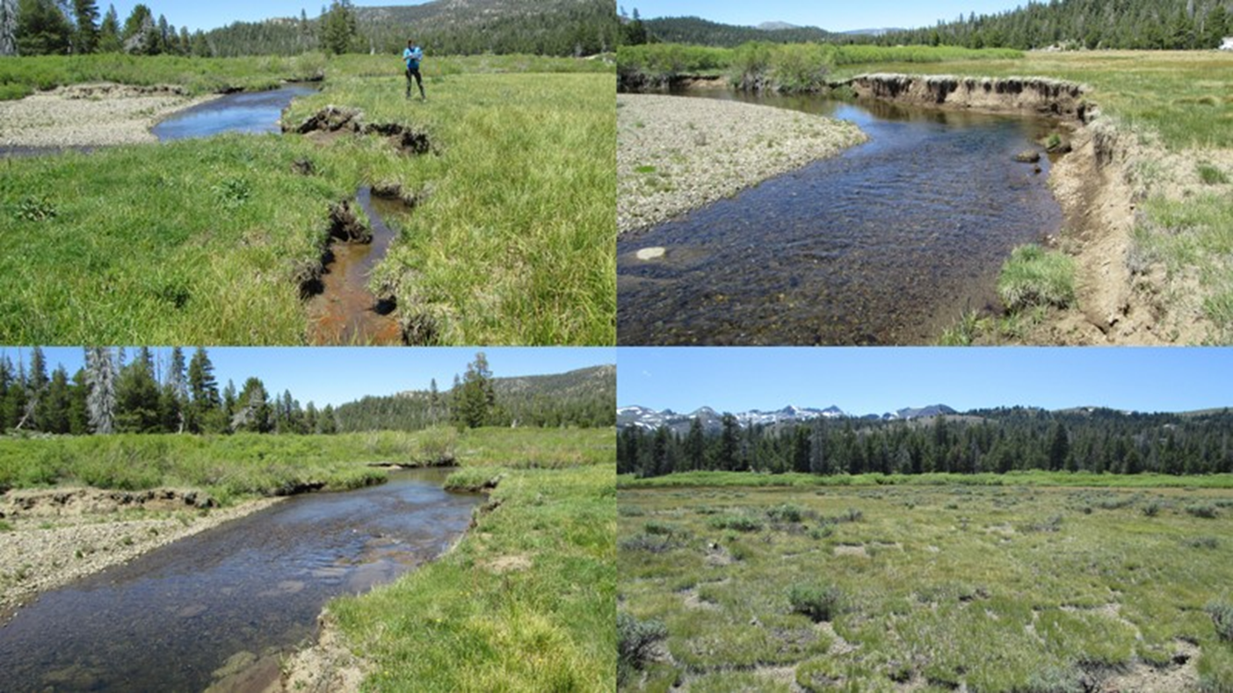
Faith Valley
Impacted bank height and stability, 2 headcuts, Yellow-legged frog critical habitat, recent willow flycatcher breeding site
Funding from National Fish and Wildlife Foundation for project planning
Notes:
3 miles upstream from Hope

Slide 13
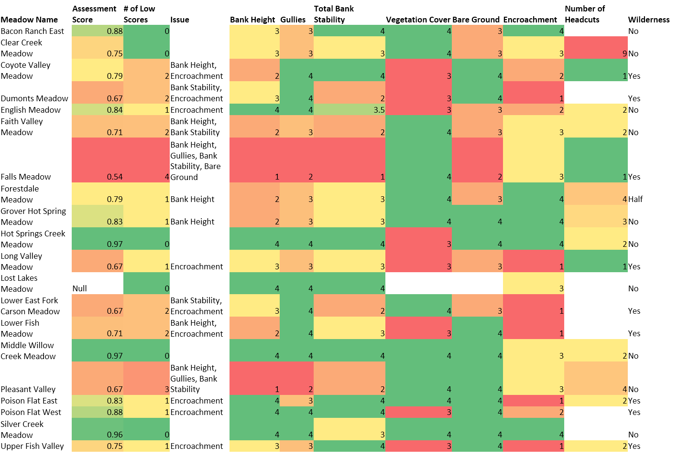
Carson Meadows Stakeholder Meeting
July 26th, 10 am – 1 pm
Carson or Markleeville
Questions?
Contact Julie Fair, American Rivers
jfair@americanrivers.org
Notes:
3 miles upstream from Hope

Slide 14
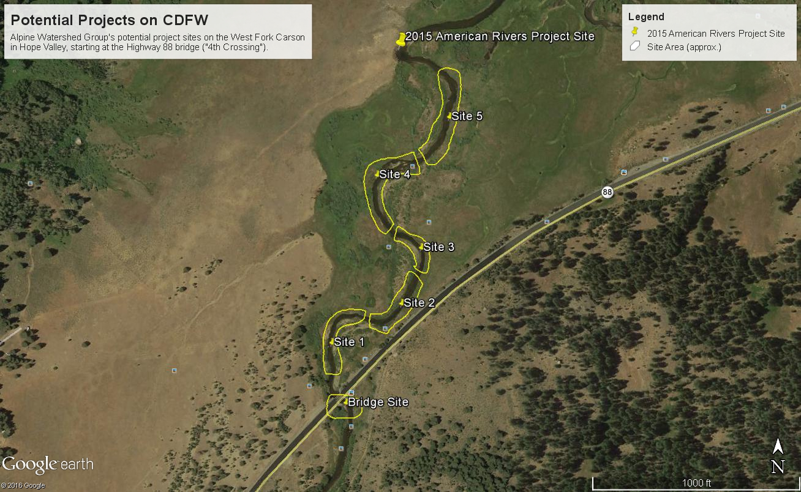
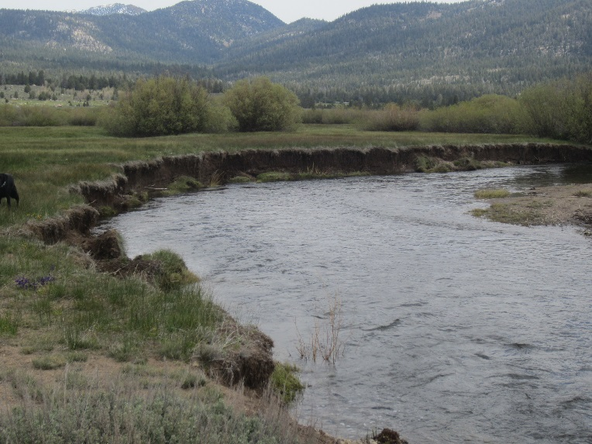
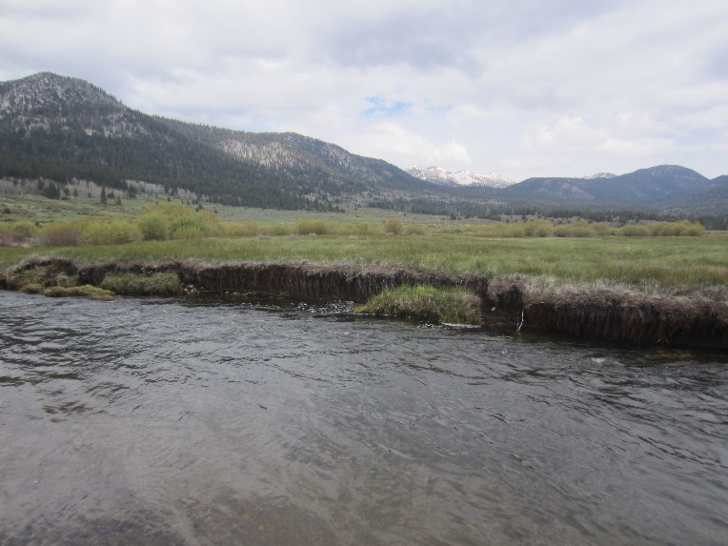
Upcoming AWG Plans in Hope Valley
Complete “bookends” created by AR
All on California Department of Fish & Wildlife Land
Planning to start summer/fall of 2017 (funding-dependent)

Slide 15
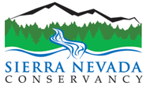
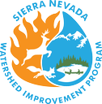
Sierra Nevada Conservancy Proposition 1 grant opportunity
More information including a Webinar: http://www.sierranevada.ca.gov/other-assistance/prop1-grantprog

Slide 16
Sierra Nevada Conservancy Proposition 1 grant opportunity
Meadow Restoration: previous guidelines did not allow these because GGRF were finding this through Fish and Wildlife, but not GGRF this year.
NOT stream/channel restoration. Has to be a forest health project with meadow component.
MUST ask SNC representative
Meadow edge projects (conifer encroachment), release projects to help aspen stands
More information including a Webinar: http://www.sierranevada.ca.gov/other-assistance/prop1-grantprog

Slide 17
Sierra Nevada Conservancy Proposition 1 grant opportunity
Scoring and evaluation: minimum score of 80/100 to be considered.
CEQA/NEPA must be complete
CC/etc consultations must be done
Downstream beneficiaries –water agencies, irrigation districts, etc. Show involvement and support from downstream. More than letter of support is ideal – show actual involvement and benefit.
Landscape level restoration: project supports broader cumulative effort and how the project fits into larger plans
More information including a Webinar: http://www.sierranevada.ca.gov/other-assistance/prop1-grantprog

Slide 18
Sierra Nevada Conservancy Proposition 1 grant opportunity
Project Ideas?
More information including a Webinar: http://www.sierranevada.ca.gov/other-assistance/prop1-grantprog

